Slide 1
BTP
END Sem Evaluation
BTP code & Guide : B22PS01
Dr. Priyambada Subudhi

Slide 2
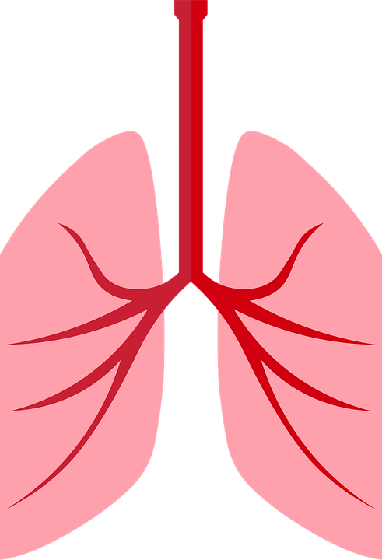
T i t l e :
Lung nodule detection in chest CT Scan images
using deep learning approaches

Slide 3
Team Members
Sri Lakshmi Prasanna Koneru
S20190010168
srilakshmiprasanna.k19@iiits.in
Indu Naik Guguloth
S20190010058
indunaik.g19@iiits.in
Saam Prasanth Deeven Pedapalli
S20190010136
saamprasanthdeevan.p19@iiits.in

Slide 4
Presentation flow
Recap
Abstract
Motivation
Our Approach for the project
Road Map
Dataset
Training and testing the data
SVM Algorithm and it’s steps in detail
KNN Algorithm
How did we predicted whether the CT Scan image is normal or abnormal.
Accuracy Graph
Future plans
Reference

Slide 5
Recap
Abstract
Motivation
Introduction

Slide 6
Abstract
Image segmentation is still an active area of research and a relevant research area in computer vision. Hundreds of image segmentation techniques have been proposed by the researchers.
We are going to explore which method gives more accurate results in detecting lung nodules. Currently, we have explored svm and knn algorithms which are giving good results, but not up to the mark yet.

Slide 7
Introduction
Lung cancer is one of the major cause of death. Lung cancer is a state which consists of uncontrollable growth of cell and tissues.
Such treatments involve surgery, chemotherapy and radiotherapy. Overall, 15% people diagnosed with lung cancer survive five year after the diagnosis.
If left untreated, this growth can spread beyond the lung by process of metastasis into nearby tissue or other parts of the body.

Slide 8
Motivation
Lung cancer is one of the major causes of cancer-related deaths due to its aggressive nature and delayed detections at advanced stages. Early detection of lung cancer is very important for the survival of an individual, and is a significant challenging problem.
Generally, chest radiographs (X-ray) and computed tomography (CT) scans are used initially for the diagnosis of the malignant nodules; however, the possible existence of benign nodules leads to erroneous decisions.
Delayed detection of lung cancer can cause serious health hazards and might even cause death. So we are trying to improve the accuracy of detecting lung nodules.

Slide 9
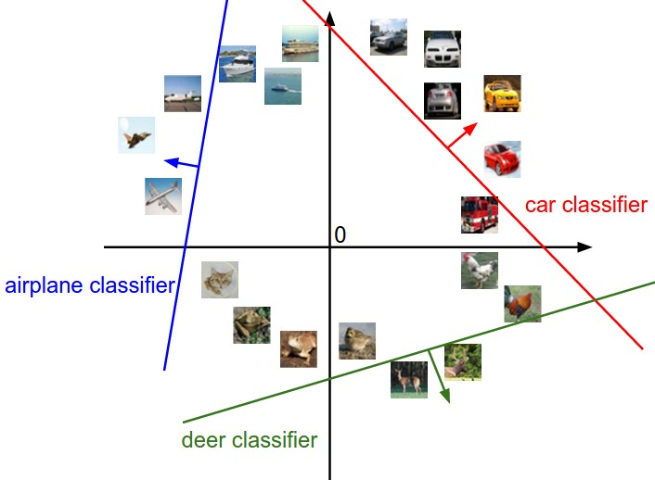
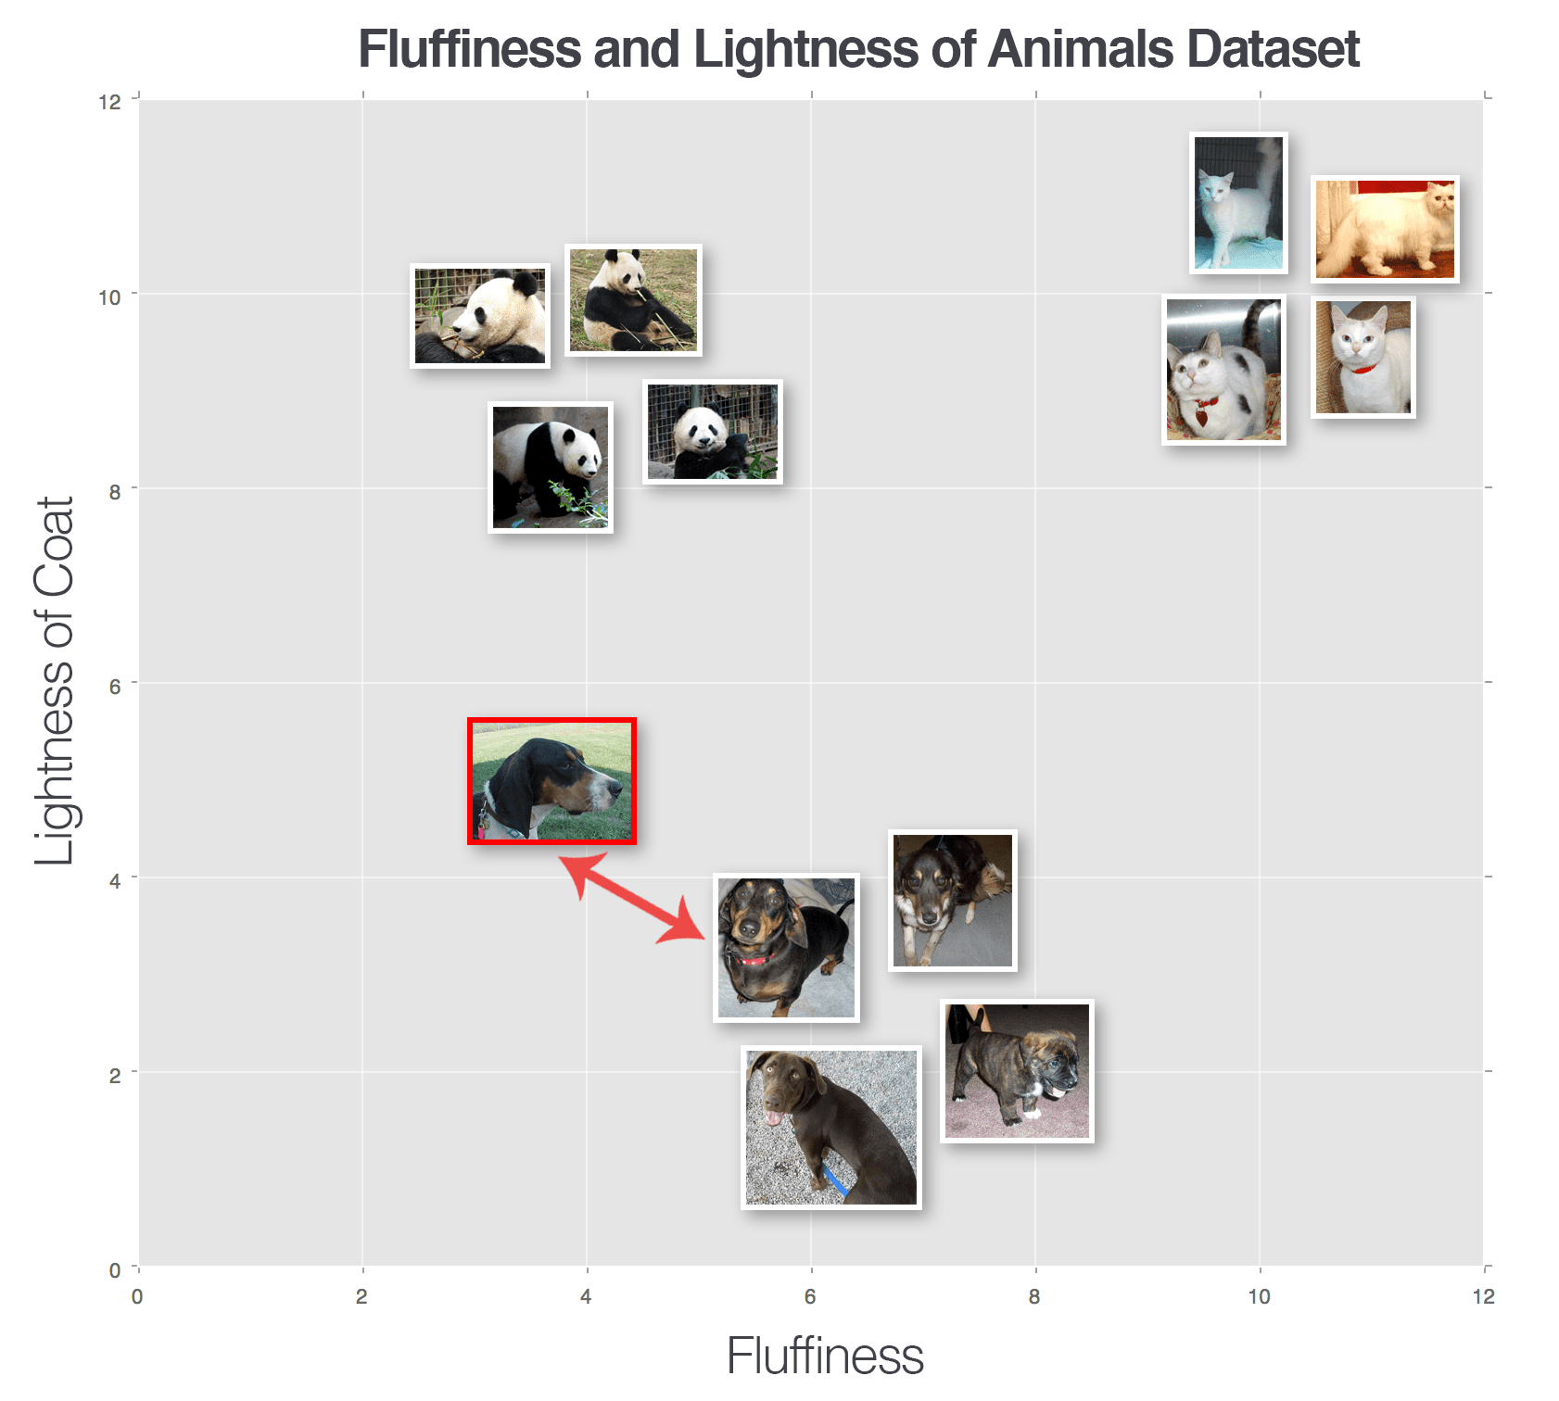
Our Approach
SVM Algorithm : Support Vector Machine
KNN Algorithm : k-nearest neighbors

Slide 10
Lunge Nodule Detection Using SVM and KNN Algorithms.
Uploading Lung cancer CT Scan dataset
Executing SVM Algorithm.
Predicting lung cancer using SVM and KNN
R
O
A
D
1
3
5
M
A P
2
4
6
Reading and splitting dataset to train and test
Executing KNN Algorithm.
Accuracy Graph

Slide 11
Steps followed for detecting lung nodules
Uploading Lung cancer CT Scan dataset
Reading and splitting dataset for training and testing
Executing SVM Algorithm
Executing KNN Algorithm
Predicting lung cancer using SVM and KNN Algorithm
Accuracy graph for SVM and KNN Algorithm

Slide 12
Dataset
Link For Dataset - Kaggle Dataset
After downloading the dataset, extract the dataset. After extracting you will find two sub folders naming as Abnormal and Normal. Total Images in the dataset are 138.
> Normal Folder
Regular chest CT scan images without any diseases.
80 Images in total.
> Abnormal folder
For the uneven CT scans images with lung nodules.
58 images in total.

Slide 13
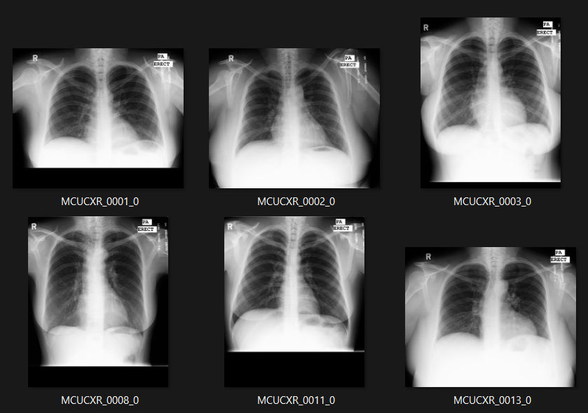
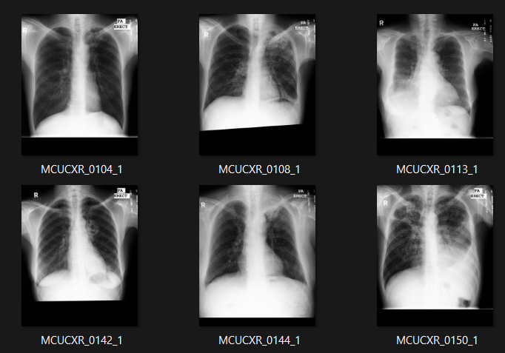
Images
Normal Images
Abnormal Images

Slide 14
Reading and splitting dataset for training and testing
Total Images in dataset are 138, we’ve split the data as 80% and test the data with 20%.
Train split dataset to 80%, 80 / 100 * 138 = 110 images
Test split dataset to 20%, 20 / 100 * 138 = 28 images
So for the Training the images we got 110 images and for testing the data we got 28 images.

Slide 15
SVM Algorithm
To classify images, here we are using SVM.
In this SVM algorithm, we plot each data item as a point in n-dimensional space (where n is the number of features you have) with the value of each feature being the value of a particular coordinate.
we perform classification by finding the hyper-plane that differentiates the two classes very well.
SVM chooses the extreme points/vectors that help in creating the hyperplane. These extreme cases are called as support vectors, and hence algorithm is termed as Support Vector Machine.

Slide 16
Advantages of SVM
The advantages of support vector machines are:
Effective in high dimensional spaces.
Still effective in cases where number of dimensions is greater than the number of samples.
Uses a subset of training points in the decision function (called support vectors), so it is also memory efficient.
Kernel : SVM algorithms use a set of mathematical functions that are defined as the kernel.

Slide 17
Process for SVM
1. Taking input
2. Model construction
3. Used PCA (Principal Component Analysis)
4. Model training
5. Model testing
6.Model evaluation

Slide 18
Taking input
Model construction
PCA
We are taking input (Images) from the dataset with 138 images. uploadDataset() function is used for uploading the dataset. Since SVM receives inputs of the same size, all images need to be resized to a fixed size before giving them as input to the SVM.
For Model Construction we’ve used function named executeSVM(), in this function we will predict the Accuracy of the SVM algorithm.
Number of components taken as 100.

Slide 19
Model training
Model testing
Model Evaluation
We are training the SVM model for 80%, Train split dataset to 80%, 80 / 100 * 138 = 110 images. So there are 110 Images.
We are testing the dataset for 20% , 20 / 100 * 136 = 28 images. So there are 28 Images.
The Accuracy for SVM and KNN as follows:
SVM : 75.0
KNN : 60.714

Slide 20
KNN
The k-NN algorithm classifies unknown data points by finding the most common class among the k closest examples.
Each data point in the k closest data points casts a vote, and the category with the highest number of votes wins.
K-NN algorithm assumes the similarity between the new case/data and available cases and put the new case into the category that is most similar to the available categories.
K-NN algorithm stores all the available data and classifies a new data point based on the similarity.
This means when new data appears then it can be easily classified into a well suite category by using K- NN algorithm.

Slide 21
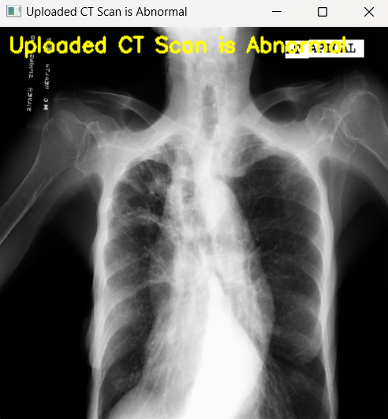
Prediction of lung cancer
If predicted output is 0 then uploaded CT scan is normal, if output is 1 then uploaded CT scan is abnormal.
Hence we can predict the lung nodules by using CT scan images.
Here in the picture, you can see that the CT scan of chest is Abnormal.

Slide 22
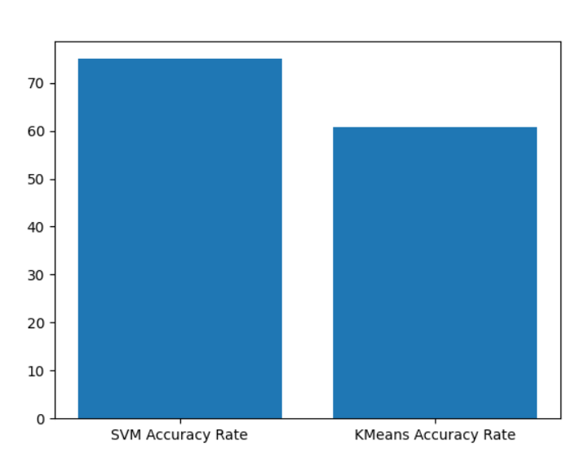

Accuracy Graph
We will plot the graph for the Accuracy for SVM and KNN Algorithms.
The Accuracy of SVM is 75% and Accuracy for KNN is around 60.71.
The below figure is graph for SVM and KNN.

Slide 23
Future Plans
Try to get a better/bigger CT scan dataset to work on.
Implement CNN algorithm in its 3 stages.
Compare and contrast the accuracy results with other algorithms implemented.
Get a better understanding of which approach will be best suited for lung nodule detection.

Slide 24
References
Paper | Authors and published date | Methodology | Output(s)
Paper 1 Deep Learning for Lung Cancer Nodules Detection and Classification in CT Scans | Diego Riquelme and Moulay A. Akhloufi, published on 8th January 2020 | CNN techniques like U-Net, Faster R-CNN, Mask R-CNN, YOLO, VGG, ResNet. | CPM (Competition Performance Metric)of 0.968, 0.966, and 0.916, respectively. All of these frameworks are 3D CNN based. AUC (area under the ROC curve)of 0.996, 0.9835 and 0.954.

Slide 25
Papers | Authors and published date | Methodology | Output(s)
Paper 2 SCPM-Net: An Anchor-free 3D Lung Nodule Detection Network using Sphere Representation and Center Points Matching | Xiangde Luo, Tao Song, Guotai Wang, Jieneng Chen, Yinan Chen, Kang Li, Dimitris N. Metaxas, Shaoting Zhang 6 Jan 2022 | Using Sphere Representation and Center Points Matching | Experimental results on the LUNA16 dataset showed that our proposed framework achieves superior performance compared with existing anchor-based and anchor-free methods for lung nodule detection.

Slide 26
Papers | Authors and published date | Methodology | Output(s)
Paper 3 Analysis of Architecture Combining Convolutional Neural Network (CNN) and Kernel K-Means Clustering for Lung Cancer Diagnosis | Zuherman Rustama, Sri Hartinia, Rivan Y. Pratamaa, Reyhan E. Yunusb, Rahmat Hidayat, published on June 2020 | Convolutional Neural Network (CNN) and Kernel K-Means clustering. | Best performance with 98.85 percent accuracy, 98.32 percent sensitivity, 99.40 percent precision, 99.39 percent specificity, and 98.86 percent F1-Score when using the RBF kernel function with sigma=0.05 in 9-fold cross-validation. It is even obtained in 48 ± 0.77 seconds.

Slide 27
T H A N K
Y O U

